Slide 1
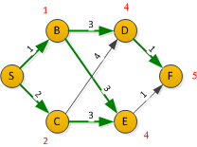

Node | D(S) | Prev | Root | D(S) | Prev | Node | D(S) | Prev | Node | D(S) | Prev
1st |  |  | S | 0
S | 0 |  | B | 1 | S | C | 2 | S
B | 1 | S | C | 2 | S | D | 4 | B | E | 4 | B
C | 2 | S | D | 4 | B | E | 4 | B
D | 4 | B | E | 4 | B | F | 5 | D
E | 4 | B | F | 5 | D
F | 5 | D

Slide 2
Pseudocode: full search [Djikstra]
LCFS/Dijkstra (G,w,s)
Initialize-search( G, s )
S = ∅ // Set of completed nodes.
Q = ∅
Enqueue(Q,s)
While Q != ∅
u = Extract-Min(Q)
S = S ∪ {u}
Record distance to u and predecessor
for each node v ∈ G.Adj[u]
if v.d > (u.d + w(u,v))
v.d = u.d + w(u,v)
v.π = u
if v is not on the queue
Enqueue(Q,v)

Slide 3
Pseudocode: Goal Search
LCFS/Dijkstra (G,w,s,goal)
Initialize-search( G, s )
S = ∅ // Set of completed nodes.
Q = ∅
Enqueue(Q,s)
While Q != ∅
u = Extract-Min(Q)
S = S ∪ {u}
if (u = goal)
halt
for each node v ∈ G.Adj[u]
if v.d > (u.d + w(u,v))
v.d = u.d + w(u,v)
v.π = u
if v is not on the queue
Enqueue(Q,v)

Slide 4
Comment on the pseudocode
LCFS/Dijkstra (G,w,s)
Initialize-search( G, s )
S = ∅
Q = G.V
While Q != ∅
u = Extract-Min(Q)
S = S ∪ {u}
Record distance to u and predecessor
for each node v ∈ G.Adj[u]
if v.d > (u.d + w(u,v))
v.d = u.d + w(u,v)
v.π = u
The Cormen text, and many classical Dijkstra’s algorithm texts, enqueues the entire graph at the beginning. This is a little more efficient than my pseudocode, but it only works if you can store the entire graph in memory.
Sometimes you are building a graph as you go, and you may not be storing the whole thing.

Slide 5
LCFS/Dijkstra’s Algorithm, Running Time
Depends on implementation of the priority queue
Array implementation: O(V²+E) = O(V²)
Insert is O(1), called O(V) times
Relax edge is O(1), called O(E) times
Extract-Min is O(V), called O(V) times
Keep priority queue sorted, O(V lg V)
BUT possible if you change one element to re-sort in O(V)
So with initial sort O(V lg V)
O(V) + O(E) + O(V lg V) + O(V²) = O(V²)

Slide 6
LCFS/Dijkstra’s Algorithm, Running Time
Binary Heap implementation: O(E lg V)
Insert is O(V), called once
Decrease-Key is O(lg V), called O(E) times
Every new edge could get you a shorted distance to a node
Extract-Min is O(lg V), called O(V) times
O(V) + O(E lf V) + O(V lg V) = O(E lg V)
Since E > V, usually
Java’s Priority Queue class uses a heap.

Slide 7
Depth-First Search (DFS)
Depth-First Search (DFS) treats the frontier as a stack.
It always selects one of the last elements added to the frontier.
If the list of paths on the frontier is [p₁, p₂, . . .]
p₁ is selected. Paths that extend p₁ are added to the front of the stack (in front of p₂).
p₂ is only selected when all paths from p₁ have been explored.

Slide 8
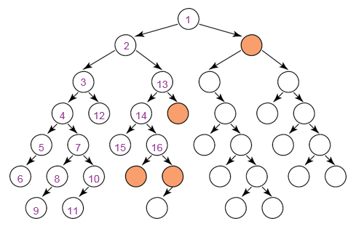
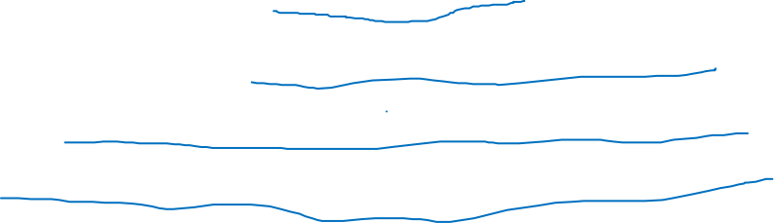
Illustrative Graph - Depth-First Search

Slide 9
Depth-First Search – Selecting Next Node
Since DFS doesn’t claim to find shortest paths, you need another rule to decide which unvisited (white, blue) node to visit next.
In the last slide, the rule was “always go left first”
In this class, the rule will be either
choose the node whose value comes first in the alphabet, or
choose the nearest node

Slide 10
DFS terminology
Every node has a color (Black, Gray, White)
Every node has two timestamps.
First timestamp is discovery time of that node
Time when grayed
Starts with 1 for start node
Second timestamp is finish time of that node
Time when blackened
Timestamps are integers, increment by 1.
Predecessor subgraph G_{π} = (V, E_{π}) where
E_{π} = { (v.π ,v) : v ∈ V and v.π ≠ ∅ }
We want to find all nodes on the graph, whether or not reachable from the source node.

Slide 11
DFS pseudocode
DFS(G)
Foreach vertex u ∈ G.V
u.color=WHITE
u.π = ∅
time = 0
Foreach vertex u ∈ G.V
if u.color == WHITE
DFSvisit(G,u)
DFSvisit(G,u)
time=time+1
u.d=time
u.color=GRAY
Foreach v adjacent to v
if v.color=WHITE
v.π = u
DFSvisit(G,v)
u.color=BLACK
time=time+1
u.f=time

Slide 12
DFS on disconnected graphs
Suppose you’re doing DFS on a graph and you finish the start node while there are still unexplored (white) nodes left.
Continue DFS by incrementing timestamp and starting from an unvisited (white) node.
You may need a rule to decide which node to visit next.
In this class, node with value that is lexicographically first.

Slide 13
Running Time of DFS
Explore each vertex once. O(|V|)
Traverse each edge twice. O(|E|)
Total: O(|V|+|E|)
Assumes that you know when you’re revisiting a node (check color), so you don’t duplicate work.

Slide 14
Complexity of Depth-First Search (DFS)
Does DFS guarantee to find the shortest path or the path with the fewest arcs?
What happens on infinite graphs or on graphs with cycles if there is a solution?
What is the time complexity as a function of length of the path selected?
What is the space complexity as a function of length of the path selected?

Slide 15
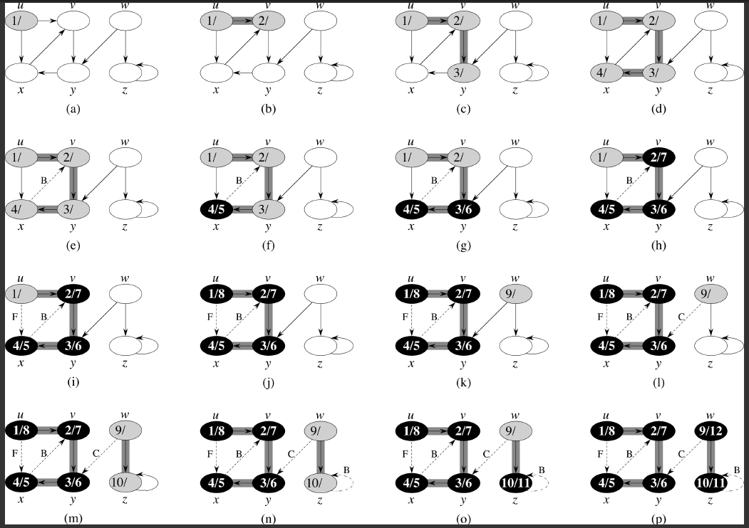
DFS: Discover/finishing “times”

Slide 16
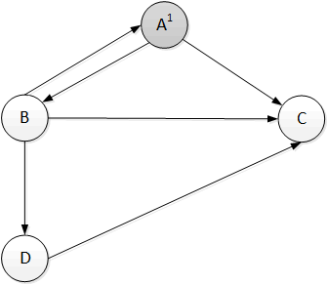
DFS Example – Step 1
Vertex | A | B | C | D
Discovery Time | 1
Finishing Time
Edge | AB
Type (BCFT)

Slide 17
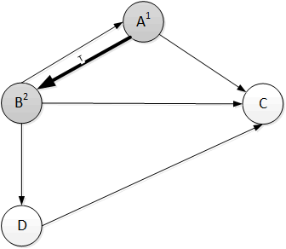
DFS Example – Step 2
Vertex | A | B | C | D
Discovery Time | 1 | 2
Finishing Time
Edge | AB | AC | BA | BC | BD | DC
Type (BCFT) | T

Slide 18
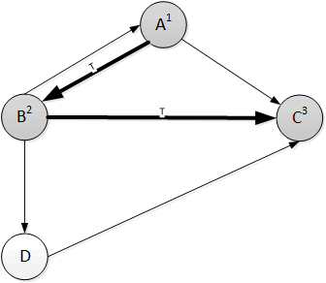
DFS Example – Step 3
Vertex | A | B | C | D
Discovery Time | 1 | 2 | 3
Finishing Time
Edge | AB | AC | BA | BC | BD | DC
Type (BCFT) | T |  |  | T

Slide 19
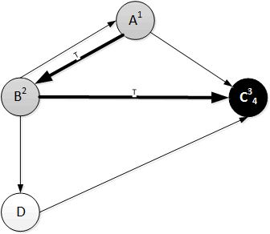
DFS Example – Step 4
Vertex | A | B | C | D
Discovery Time | 1 | 2 | 3
Finishing Time |  |  | 4
Edge | AB | AC | BA | BC | BD | DC
Type (BCFT) | T |  |  | T

Slide 20
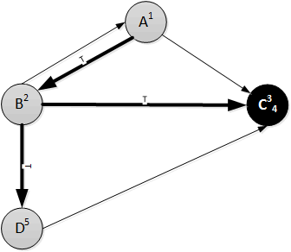
DFS Example – Step 5
Vertex | A | B | C | D
Discovery Time | 1 | 2 | 3 | 5
Finishing Time |  |  | 4
Edge | AB | AC | BA | BC | BD | DC
Type (BCFT) | T |  |  | T

